Slide 1

Multiprocessor and
Real-Time Scheduling
Chapter 10

Slide 2
Classification of Multiprocessor Systems
Loosely coupled multiprocessor
  Each processor has its own memory and I/O channels
  Message-passing
  Distributed memory
Tightly coupled multiprocessors
  Shared memory (e.g. single address space)
  Controlled by a central operating system
  Symmetric Multiprocessors
Functionally specialized processors
  Such as I/O processor
  Controlled by a master processor

Slide 3
Types of Parallelism
Independent parallelism
  Separate applications or jobs running on multiple processors
  No synchronization between them
  Average response time to users is small
Coarse-Grained Parallelism
  Synchronization among processes at a very gross level
  Example: a collection of processes running on seperate processors
  and interacting with each other once in a while
Medium-Grained Parallelism
  Parallel processing or multitasking within a single application
  Single application is a collection of threads which interact frequently
Fine-Grained Parallelism
  Highly parallel applications
  parallelism at instruction level
  lots of synchronization and communication between processes
  Ex: “sorting a list in parallel” or “finding prime numbers in parallel”

Slide 4
Scheduling
Assignment of processes to processors
Should multiprogramming be used on individual processors?
  depends on the goal and the application . If we want to get maximum speedup by running an application in parallel, then we may want to dedicate the processors to the processes of a single application.
Single queue for all processes. A process can be scheduled to run on any processor.
Multiple queues can be used for priorities.
All queues feed to the common pool of processors
Specific scheduling disciplines (i.e. FCFS, RR, SPN, SRT, etc.) is less important with more than one processor. Because, it is very difficult to separate processes into disjoint queues one per processor beforehand.

Slide 5
Assignment of Processes to Processors
Treat processors as a pooled resource and assign processes to processors on demand
Global queue: Schedule to any available processor
Master/slave architecture
  Key kernel functions always run on a particular processor
  Master is responsible for scheduling
  Slave sends service request to the master
  Disadvantages
    Failure of master brings down the whole system
    Master can become a performance bottleneck
Permanently assign process to a processor
  Dedicate short-term queue for each processor
  Less overhead
  Processor could be idle while another processor has a backlog

Slide 6
Multiprocessor Thread Scheduling
An application can be a set of threads that cooperate and execute concurrently in the same address space
Threads running on separate processors yields a dramatic gain in performance
Load sharing
  Processes are not assigned to a fixed processor
Gang scheduling
  A set of related threads is scheduled to run on a set of processors at the same time

Slide 7
Load Sharing
Load is distributed evenly across the processors
No centralized scheduler required
Use global queues
Disadvantages of Load Sharing
Central queue needs mutual exclusion
  May be a bottleneck when more than one processor looks for work at the same time
Preemptive threads are unlikely to resume execution on the same processor
  May need to migrate. Cache use is less efficient
If all threads are in the global queue, all threads of a program will not gain access to the processors at the same time

Slide 8
Gang Scheduling
Simultaneous scheduling of threads that make up a single process
Useful for applications where performance severely degrades when any part of the application is not running
Threads often need to synchronize with each other

Slide 9
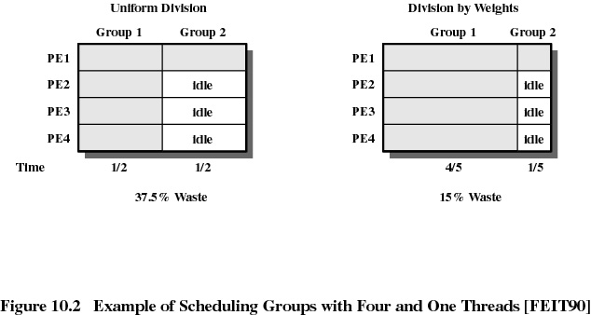
Gang Scheduling (scheduling groups)

Slide 10
Real-Time Systems
Correctness of the system depends not only on the logical result of the computation but also on the time at which the results are produced
Tasks or processes attempt to control or react to events that take place in the outside world in “real-time” and process must be able to keep up with them
Hard real-time task: must meet the deadline
Soft real-time task: meeting the deadline is nice but not mandatory
Examples:
  Control of laboratory experiments
  Process control plants
  Robotics
  Air traffic control
  Telecommunications
  Military command and control systems

Slide 11
Characteristics of Real-Time OS
Deterministic
  Operations are performed at fixed, predetermined times or within predetermined time intervals
  How fast can the OS respond to high priority interrupts?
  Could there be a deterministic upper bound?
Responsiveness
  How long, after acknowledgment, it takes the OS to service the interrupt. Includes the amount of time to begin execution and perform the ISR (Interrupt Service Routine)
User control - user specifies:
  priorities and rights of processes
  what processes must always reside in main memory
  disk transfer algorithms to use
Reliability
  Degradation of performance may have catastrophic consequences
  Fail-safe operation: Attempt either to correct the problem or minimize its effects while continuing to run
  Most critical, high priority tasks execute first

Slide 12
Features of Real-Time OS
Fast context switch
Small size
Ability to respond to external interrupts quickly
Multitasking with interprocess communication tools such as semaphores, signals, and events
Use files that accumulate data at a fast rate
Preemptive scheduling based on priorities
Minimization of intervals during which interrupts are disabled
Delay tasks for fixed amount of time
Special alarms and timeouts

Slide 13
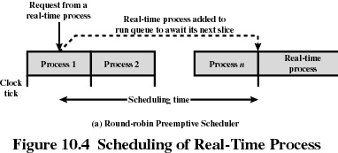
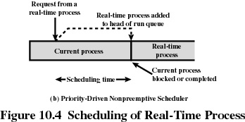
Scheduling of a Real-Time Process

Slide 14
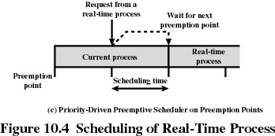
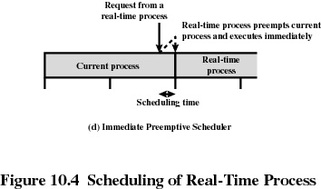
Scheduling of a Real-Time Process

Slide 15
Deadline Scheduling
Real-time applications are not concerned with fairness or minimizing the response time but with completing certain tasks in a timely manner (i.e. before their deadlines are reached)
Scheduling tasks with the earliest deadline could minimize the number of tasks that miss their deadlines
Information used
  Ready time (known in advance for periodic tasks)
  Starting deadline (time by which a task must begin running)
  Completion deadline (time by which task must be completed)
  Processing time
  Resource requirements
  Priority

Slide 16
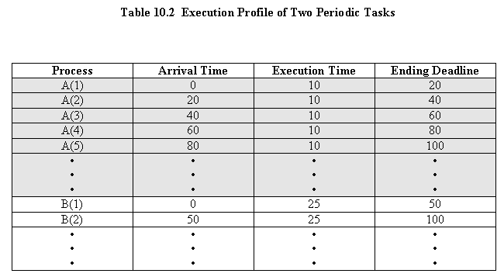
Two Tasks

Slide 17
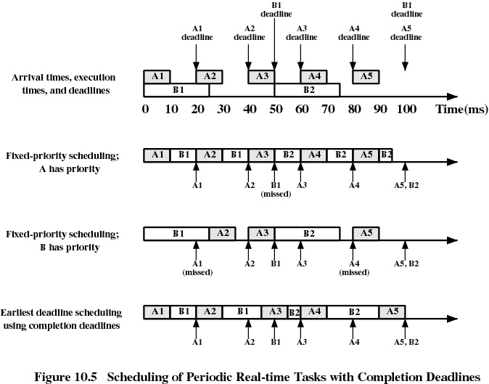

Slide 18
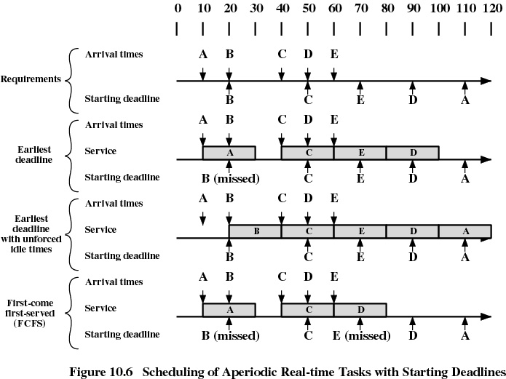

Slide 19
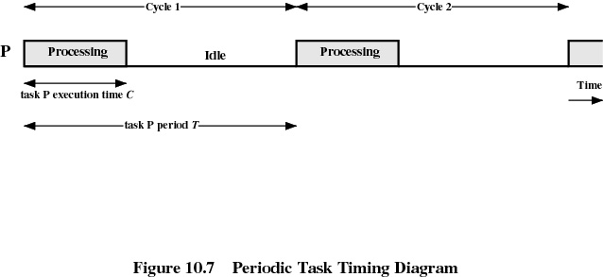
Rate Monotonic Scheduling
Assigns priorities to tasks on the basis of their periods
Highest-priority task is the one with the shortest period
Processor Utilization = C₁/T₁ + C₂/T₂ + … C_{n}/T_{n} ≤ 1
Upper Bound for RMS: C₁/T₁ + C₂/T₂ + … C_{n}/T_{n} ≤ n(2^{1/n}-1)

Slide 20
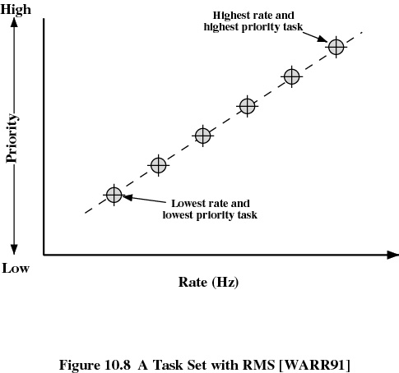

Slide 21
Value of the RMS Upper Bound
C₁/T₁ + C₂/T₂ + … C_{n}/T_{n} ≤ n(2^{1/n}-1)
n n(2 ^{1/n} -1)
______________________________
1 1.0
2 0.828
3 0.779
4 0.756
5 0.743
6 0.734
• •
• •
• •
∞ ln 2 » 0.693

Slide 22
UNIX SVR4 Scheduling
Highest preference to real-time processes
Next-highest to kernel-mode processes
Lowest preference to other user-mode processes
LINUX Scheduling
Scheduling classes
  SCHED_FIFO: First-in-first-out real-time threads
  SCHED_RR: Round-robin real-time threads
  SCHED_OTHER: Other, non-real-time threads
Within each class multiple priorities may be used
Windows 2000 Scheduling
Priorities organized into two bands (classes): Real-time vs. Variable
Priority-driven preemptive scheduler

